Slide 1

Next Generation Science Standards 101
Part 3: Uncovering the Crosscutting Concepts
Kirk Robbins
Teachscience4all.wordpress.com
@science_4_all

Slide 2

Audience: K-12 Teachers
Bethel
Clover Park
Federal Way
Franklin Pierce
Puyallup
Tacoma
Steilacoom
Sumner
White River

Slide 3
Special Thanks
Washington State LASER
www.wastatelaser.org
South Sound LASER Alliance
Regional Science Coordinators
www.washingtonesds.org

Slide 4
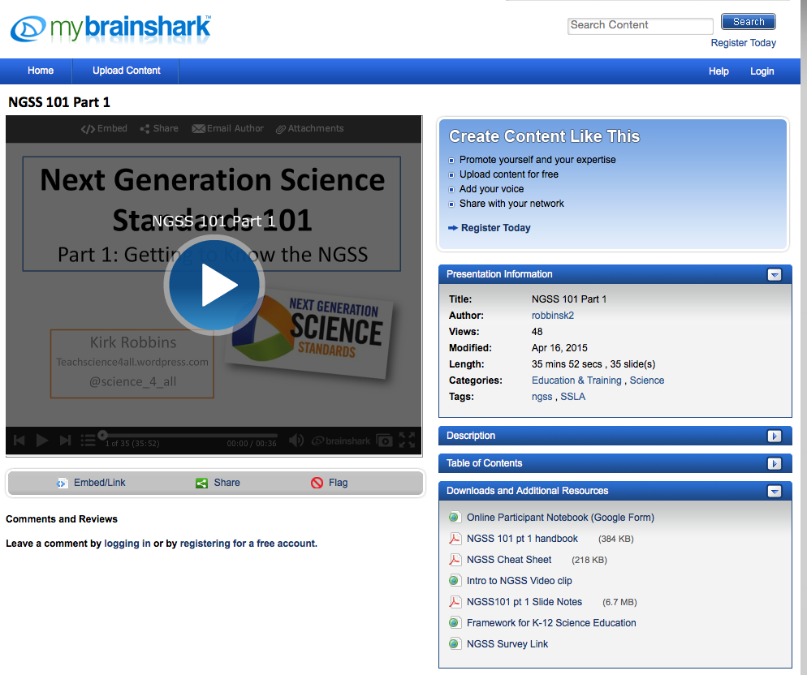
Getting Ready
Find a partner
Engage with the tasks
Download the documents
**Use Google Form link if requested by your district
Set aside 60 minutes
Be prepared to pause video
Links

Slide 5
AGENDA
What are the Crosscutting Concepts?
Identifying the Crosscutting Concepts in a Video Case
Using questions to direct students to the Crosscutting Concepts
Reading about the Crosscutting Concepts
Video Case: Teachers learning about the Crosscutting Concepts

Slide 6
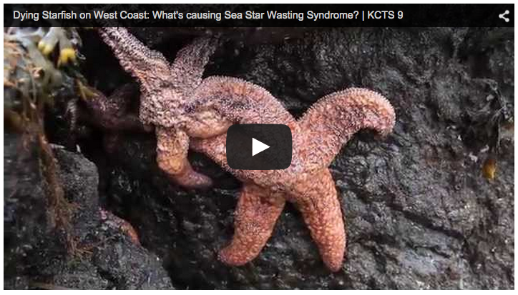
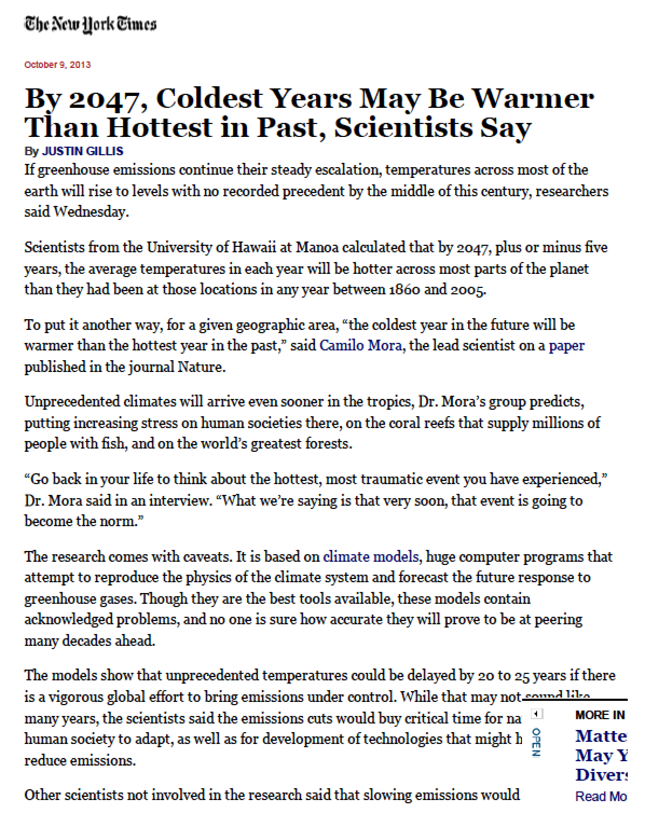
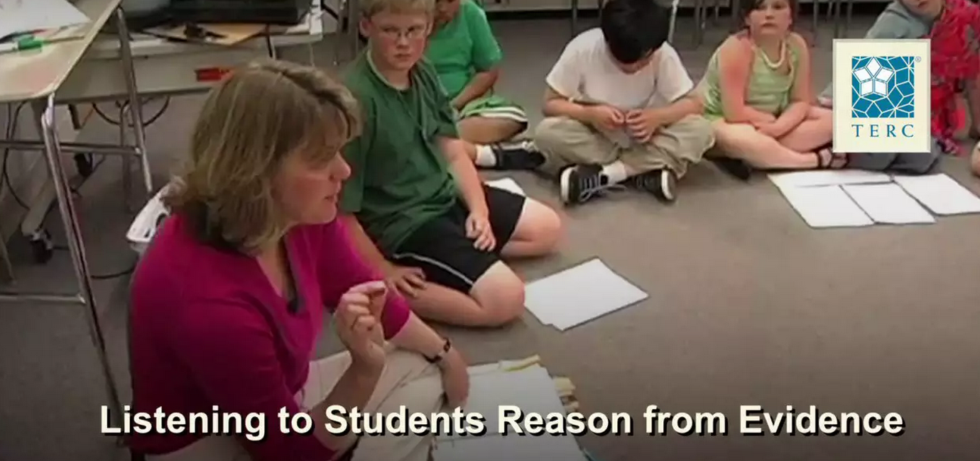
Last Time
Ask questions (for science) and define problems (for engineering)
Develop and use models
Plan and carry out investigations
Analyze and interpret data
Use mathematics and computational thinking
Construct explanations (for science) and design solutions (for engineering)
Engage in argument from evidence
Obtain, evaluate, and communicate information

Slide 7
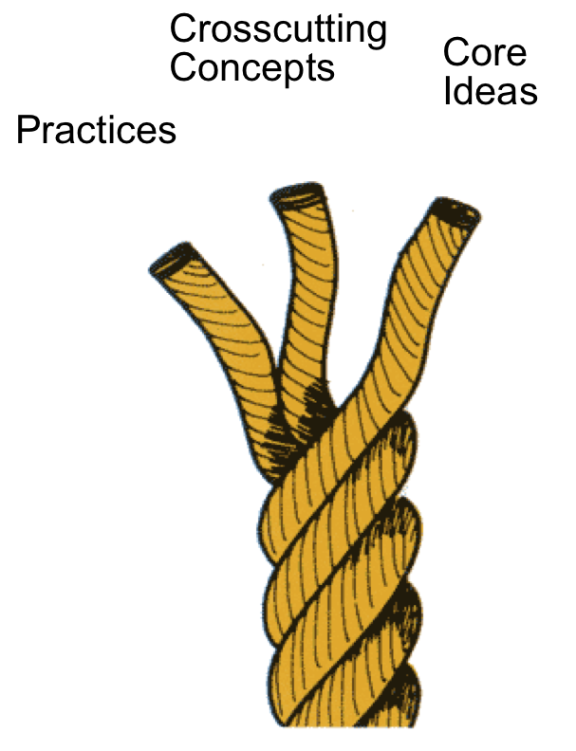
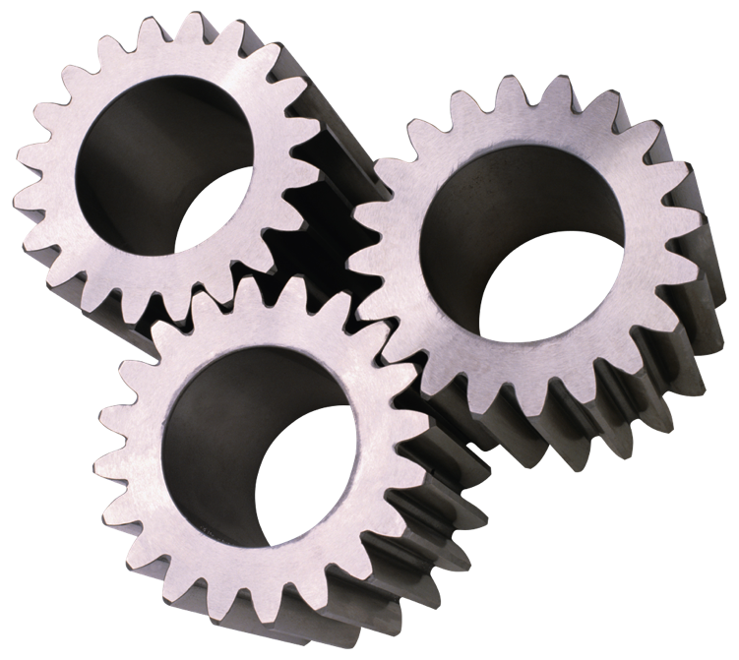
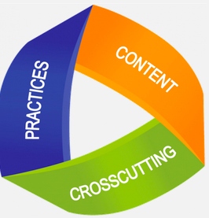
What’s Different about NGSS?
Integrating the 3 Dimensions
Science & Engineering Practices
Disciplinary Core Ideas
Crosscutting Concepts

Slide 8

Dimension 2:
Crosscutting Concepts
Patterns
Cause and effect
Scale, proportion, and quantity
Systems and system models
Energy and matter
Structure and function
Stability and change

Slide 9


Precursors to Crosscutting Concepts
Unifying Concepts and Process Standards
Common Themes
Systems, order, and organization
Evidence, models, and explanation
Change, constancy, and measurement
Evolution and equilibrium
Form and function
Systems
Models
Constancy and Change
Scale

Slide 10
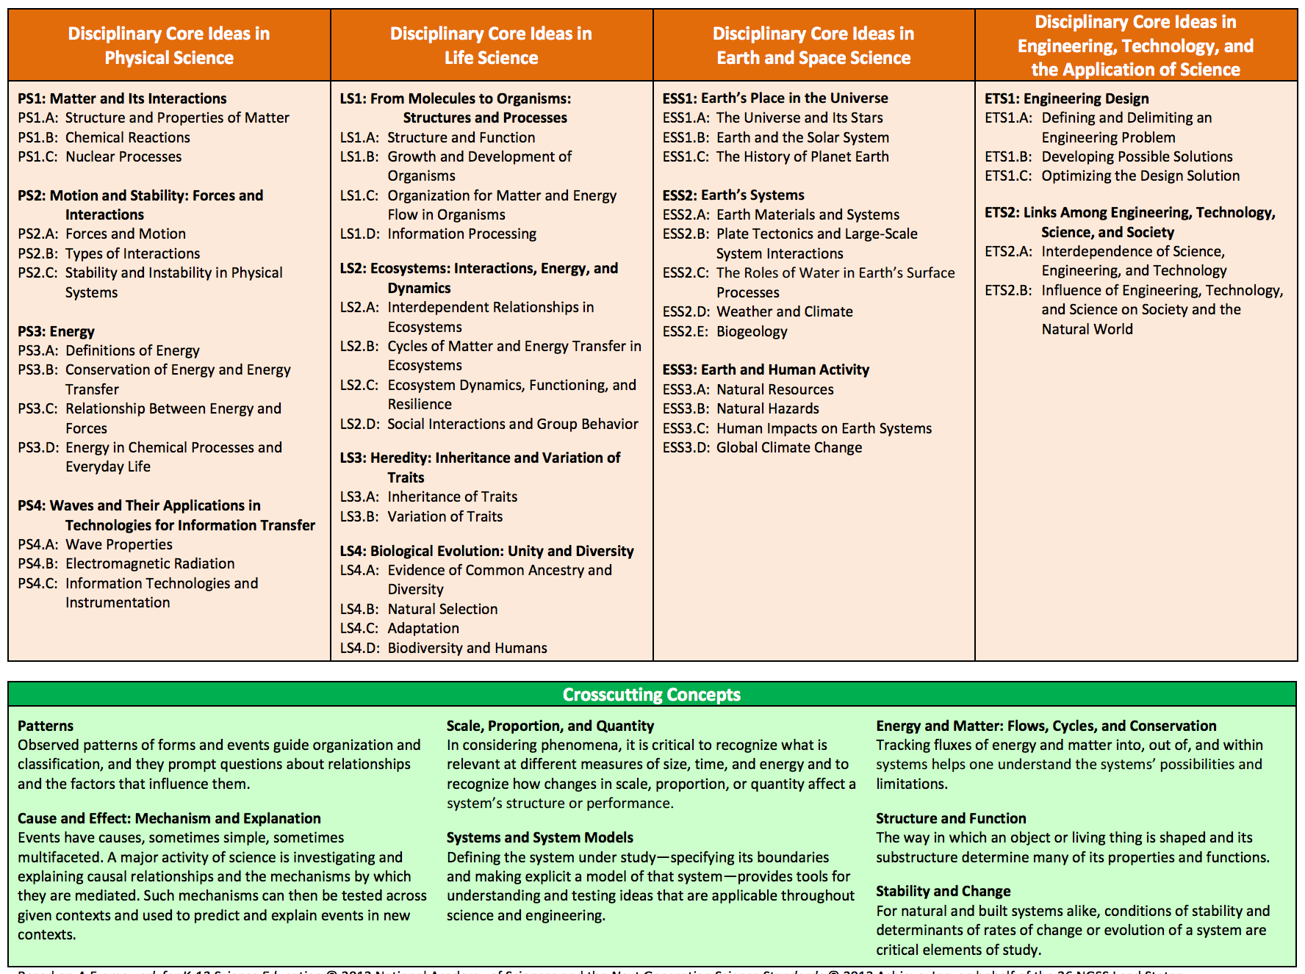
Crosscutting Concepts
Review the 7 Crosscutting Concepts

Slide 11
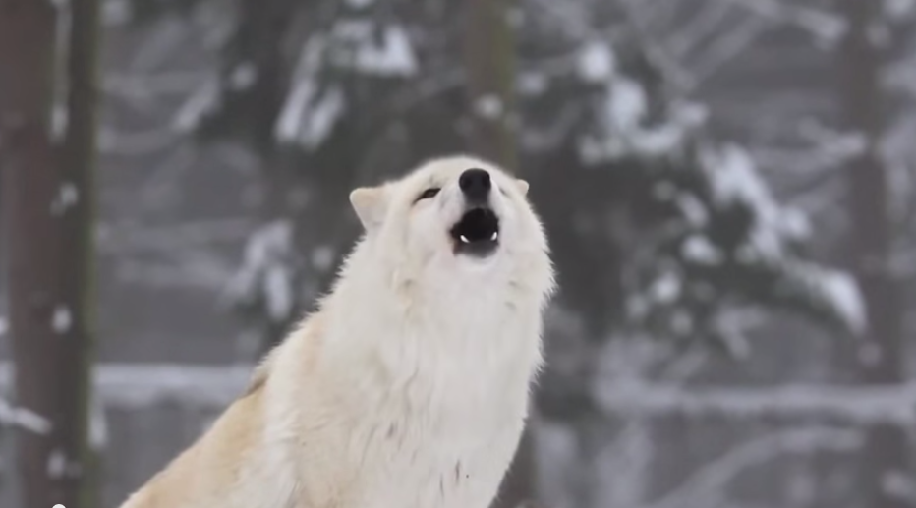
Video: How Wolves Change Rivers
NOTEBOOK:
As you watch the video jot down connections to the seven Crosscutting Concepts

Slide 12
Debriefing the Video
Crosscutting Concept | Possible Evidence from Wolves Video
Patterns | Behavior of deer
Cause and Effect | * Overt theme in video- wolves caused a cascade of effects in the system
Scale, Proportion, & Quantity | A small number of wolves had a huge impact on the system
Systems & Systems Models | * Clear theme in the video- living and non-living parts of the system are interconnected
Energy and Matter | * Food web shows the flow of energy and matter through the parts of the system
Structure and Function | Wolves led to a change in the structure of the ecosystem which led to changes in the river
Stability and Change | The system was stable and then the wolves changed the system and caused a new stability

Slide 13

Analyzing a Hand Bubbler
Watch the Hand Bubbler video
Write at least one question for each of the 7 Crosscutting Concepts that could help students understand the Hand Bubbler and how it might work
Use p. __ in your notebook

Slide 14
Debriefing the Hand Bubbler
Crosscutting Concept | Possible Evidence from Wolves Video
Patterns | What patterns do you notice in where to hold the hand bubbler to cause the liquid to move?
Cause and Effect | What is causing the liquid to move?
Scale, Proportion, & Quantity | Would a larger hand bubbler work the same way?
Systems & Systems Models | What parts of the system would we want to include in order to explain how the system works?
Energy and Matter | How might our understanding of energy transfers help us explain how the system works?
Structure and Function | What do you notice about the structure of the glass tube in the bottom bulb? How might the structure of this part be important to the function of the system?
Stability and Change | What changes in the system when you add heat from your hands?

Slide 15
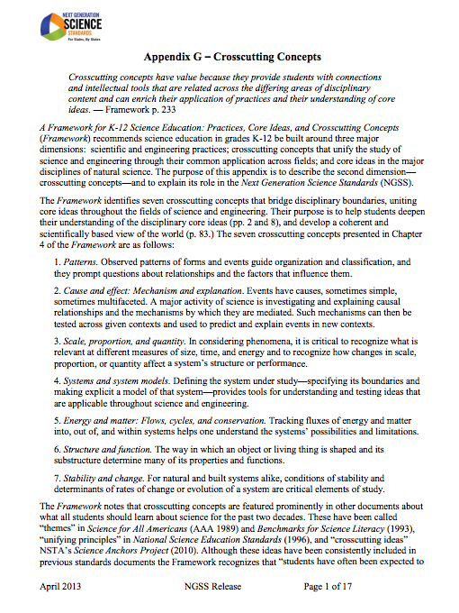
NGSS Appendix G: Crosscutting Concepts
Read the Following 3 Parts:
All: Skim p. 1-3
Read about ONE of the Crosscutting Concepts. You might want to pick one that you are a bit unsure about.
All: Skim p. 11-12 How are the Crosscutting Concepts Connected?

Slide 16
DEBRIEFING NGSS Appendix G: Crosscutting Concepts
p. 1-3 (Guiding Principles)
Crosscutting Concepts can help students better understand core ideas in science and engineering
Crosscutting Concepts can provide a common vocabulary for science and engineering
Crosscutting Concepts should not be assessed separately from practices or core ideas
p. 11-12 (Grouping Crosscutting Concepts into 3 Categories)
Patterns:
  Patterns
Causality:
  Cause and Effect
  Structure and Function
Systems:
  Systems and Systems Models
  Scale, Proportion, and Quantity
  Energy and Matter
  Stability and Change

Slide 17
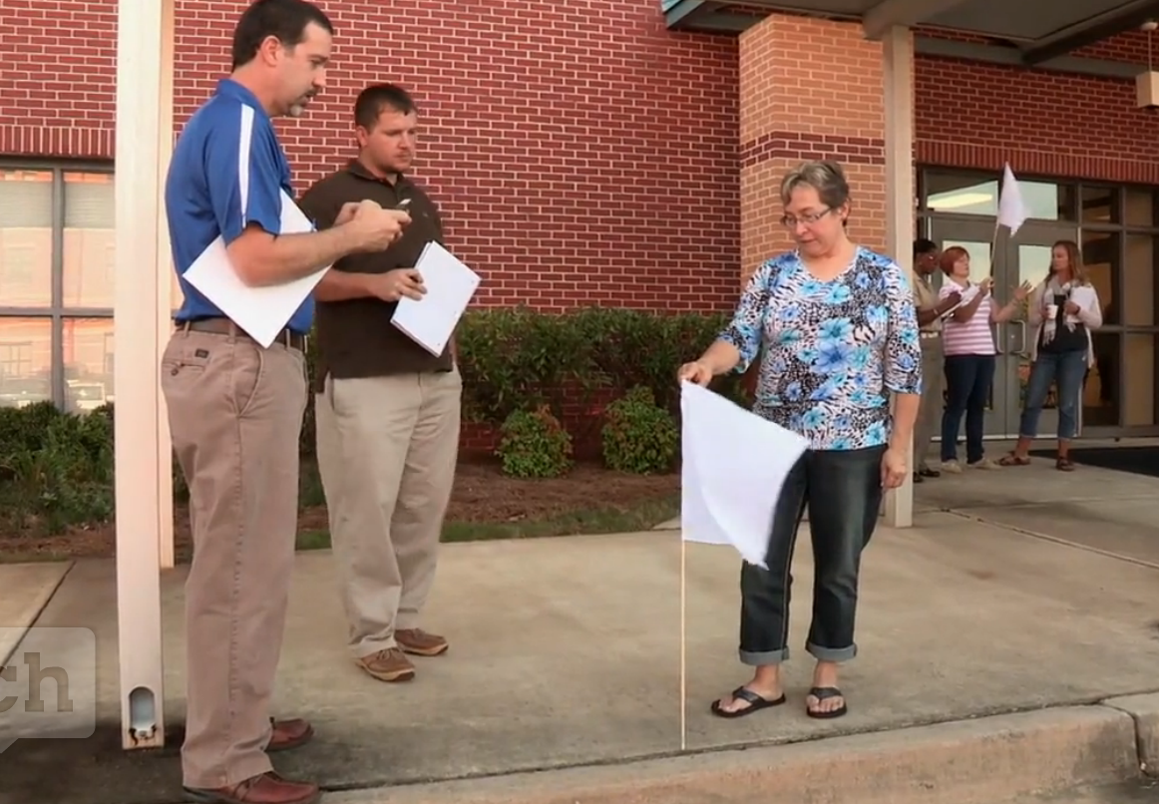
Video Case: Teacher Learning
As you watch the video:
Which Crosscutting Concepts do you notice the teachers using?
Capture quotes and ideas that resonate with you or help your understanding of the Crosscutting Concepts
Take notes on p. 3 in your packet

Slide 18
Debriefing the Video
Crosscutting Concepts are for students… helps them make sense of the science and engineering
Crosscutting Concepts should be familiar touchstones
Being intentional about the Crosscutting Concepts
Crosscutting Concepts help students make connections between domains of science and engineering

Slide 19
Final Reflection
Page 4 in your packet
Please answer in the Google Form if requested by your district

Slide 20
Next Session Online Session
Next Generation Science Standards 101
Part 4:
Engineering Design Process in the NGSS

