Slide 1

Next Generation Science Standards 101
Part 2: Digging into the Science & Engineering Practices
Kirk Robbins
Teachscience4all.wordpress.com
@science_4_all

Slide 2

Audience: K-12 Teachers
Bethel
Clover Park
Federal Way
Franklin Pierce
Puyallup
Tacoma
Steilacoom
Sumner
White River

Slide 3
Special Thanks
Washington State LASER
www.wastatelaser.org
South Sound LASER Alliance
Regional Science Coordinators
www.washingtonesds.org

Slide 4
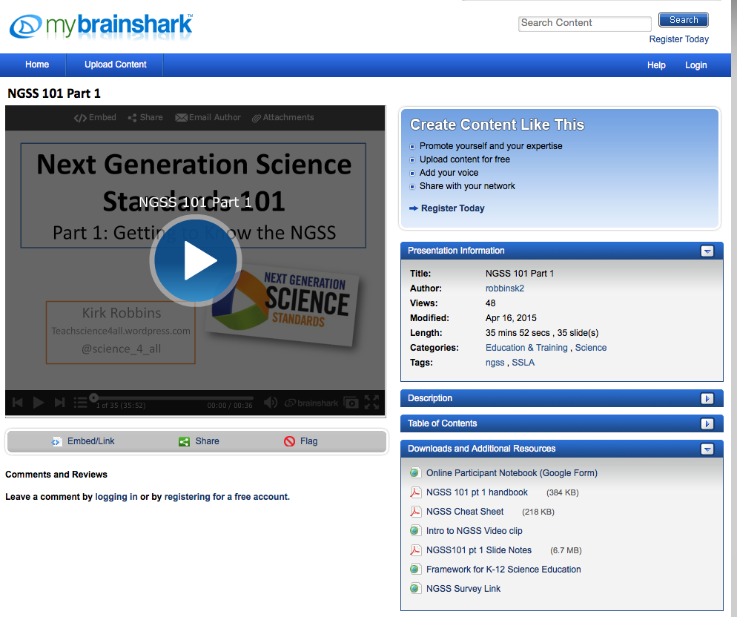
Getting Ready
Find a partner
Engage with the tasks
Download the documents
**Use Google Form link if requested by your district
Set aside 90-120 minutes
Be prepared to pause video
Links

Slide 5
AGENDA
What does it mean to “Do Science”?
What are the science & engineering practices?
Are the science & engineering practices authentic?
  Identifying the Science & Engineering Practices in a Video Case
  Analyze the Science & Engineering Practices in a piece of Text
  Classroom Case: Science & Engineering Practices in the classroom

Slide 6
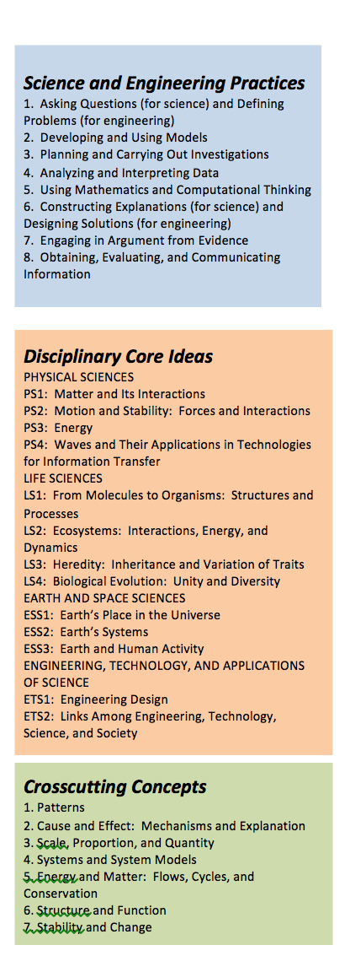
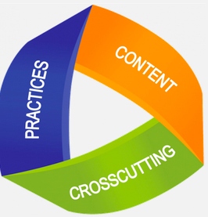
Last Time
  Children are born investigators
  Focus on core ideas and practices
  Understanding develops over time
  Science and engineering require both knowledge and practice
  Connecting to students’ interests and experiences
  Promoting equity

Slide 7
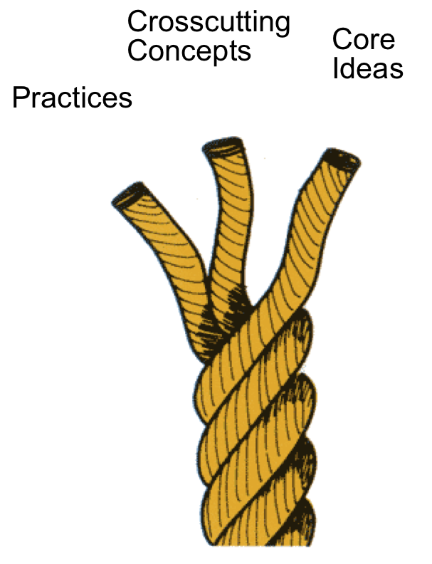

What’s Different about NGSS?
Integrating the 3 Dimensions
Science & Engineering Practices
Disciplinary Core Ideas
Crosscutting Concepts

Slide 8
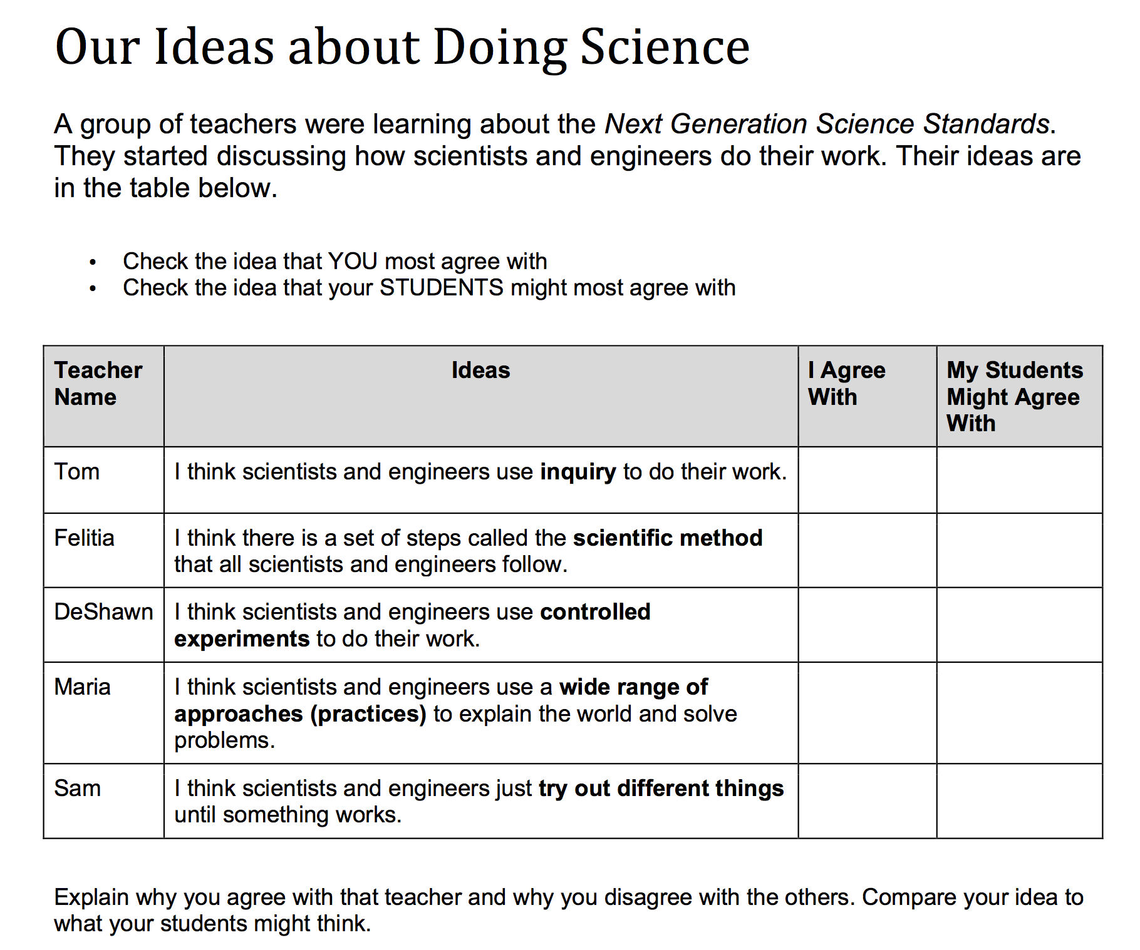
How do we “do science”?
Take 3 minutes to answer the Doing Science Probe on p.2 in your packet
Share with a partner when you are done

Slide 9
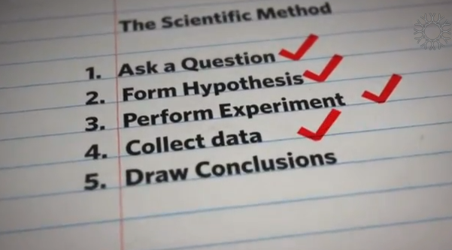
Video: How Science Works
Short video describing discovery of a new species of spider

Slide 10
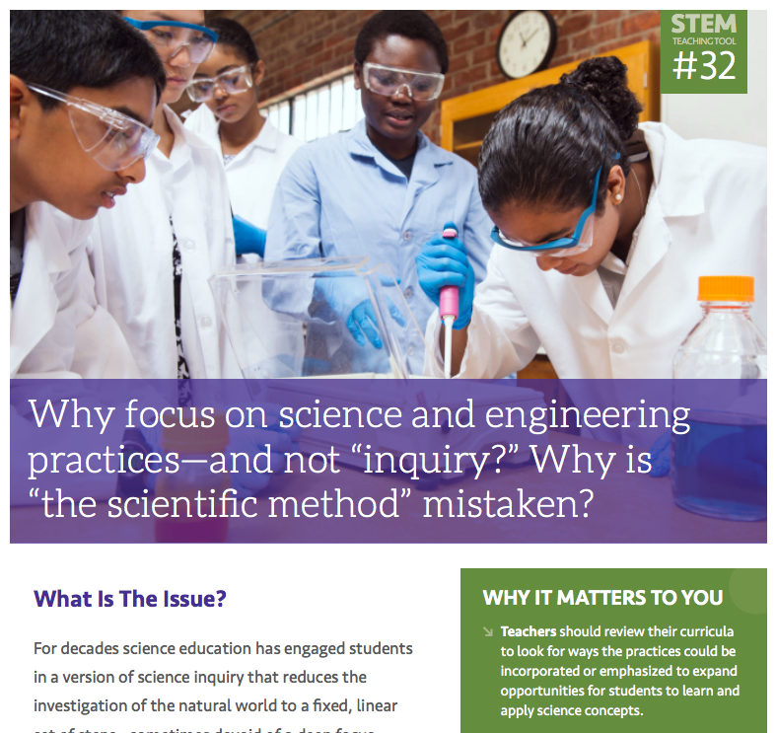
Optional Reading:
Why focus on science and engineering practices and not “inquiry”? Why is “the scientific method” mistaken?
Inquiry?
the scientific method?
Stemteachingtools.org

Slide 11

Dimension 1:
Science and Engineering Practices
Ask questions (for science) and define problems (for engineering)
Develop and use models
Plan and carry out investigations
Analyze and interpret data
Use mathematics and computational thinking
Construct explanations (for science) and design solutions (for engineering)
Engage in argument from evidence
Obtain, evaluate, and communicate information

Slide 12
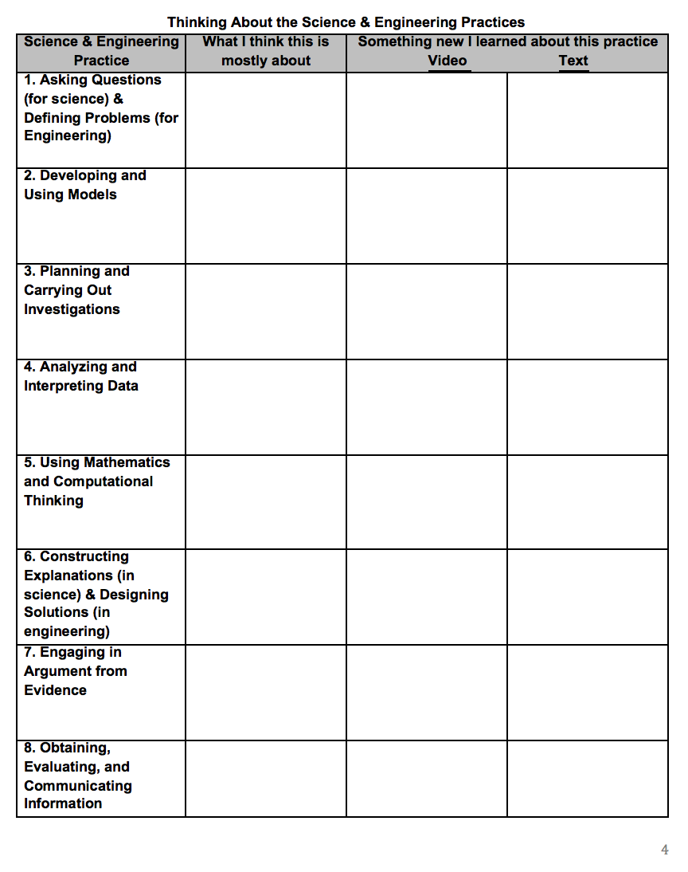
Examining the Practices
1. Turn to p. 3 in your packet
2. With a partner- complete the column titled: What I Think this is Mostly About… for each of the practices
Jot down a key word or phrase for each practice

Slide 13
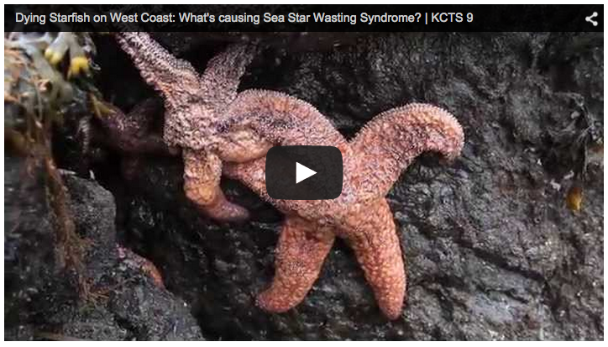
Video Case: Sea Star Wasting Syndrome
As you watch the video- jot down evidence of the Science & Engineering Practices on p. 3

Slide 14
1. Asking Questions (Science) & Defining Problems (Engineering)
Video:
“What is killing the sea stars?”
“How might we help the sea stars?”
Other Notes:
Engineers also ask questions
Students should be asking questions during all 8 of the science & engineering practices

Slide 15
2. Developing and Using Models
Video:
Map, #sickstarfish
Other Notes:
Not just Physical Models…Diagrams, drawings, and mathematical representations are also models

Slide 16
3. Planning and Carrying Out Investigations
Video:
Observations of sea stars
Infectiousness experiments
Other Notes:
May include elements from all of the other practices
More than just Experiments… Field Studies and systematic observations are key

Slide 17
4. Analyzing and Interpreting Data
Video:
Making sense of experiments and observations
Other Notes:
Not just numbers
  Observations, pictures, drawings, etc
Use digital tools when possible and feasible

Slide 18
5. Using Math & Computational Thinking
Video:
Infer that lots of math and computational thinking is happening in background
#sickstarfish
Other Notes:
Let students decide when to use qualitative vs quantitative data
Identify opportunities for students to use digital tools

Slide 19
6. Constructing Explanations (Science) & Designing Solutions (Engineering)
Video:
Lots of tentative claims
This video shows constructing an explanation in action
Other Notes:
Great connection with Common Core ELA: Evidence-Based explanations

Slide 20
7. Engaging in Argument from Evidence
Video:
Trying to identify cause of the syndrome
Other Notes:
Essential for identifying the best explanations and the best design solutions
Argumentation happens during many of the practices

Slide 21
8. Obtaining, Evaluating, and Communicating Information
Video:
Video is communicating with us
Scientists and citizens obtaining and communicating together
Other Notes:
Real scientists and engineers spend over 50% of their time engaged in this practice

Slide 22
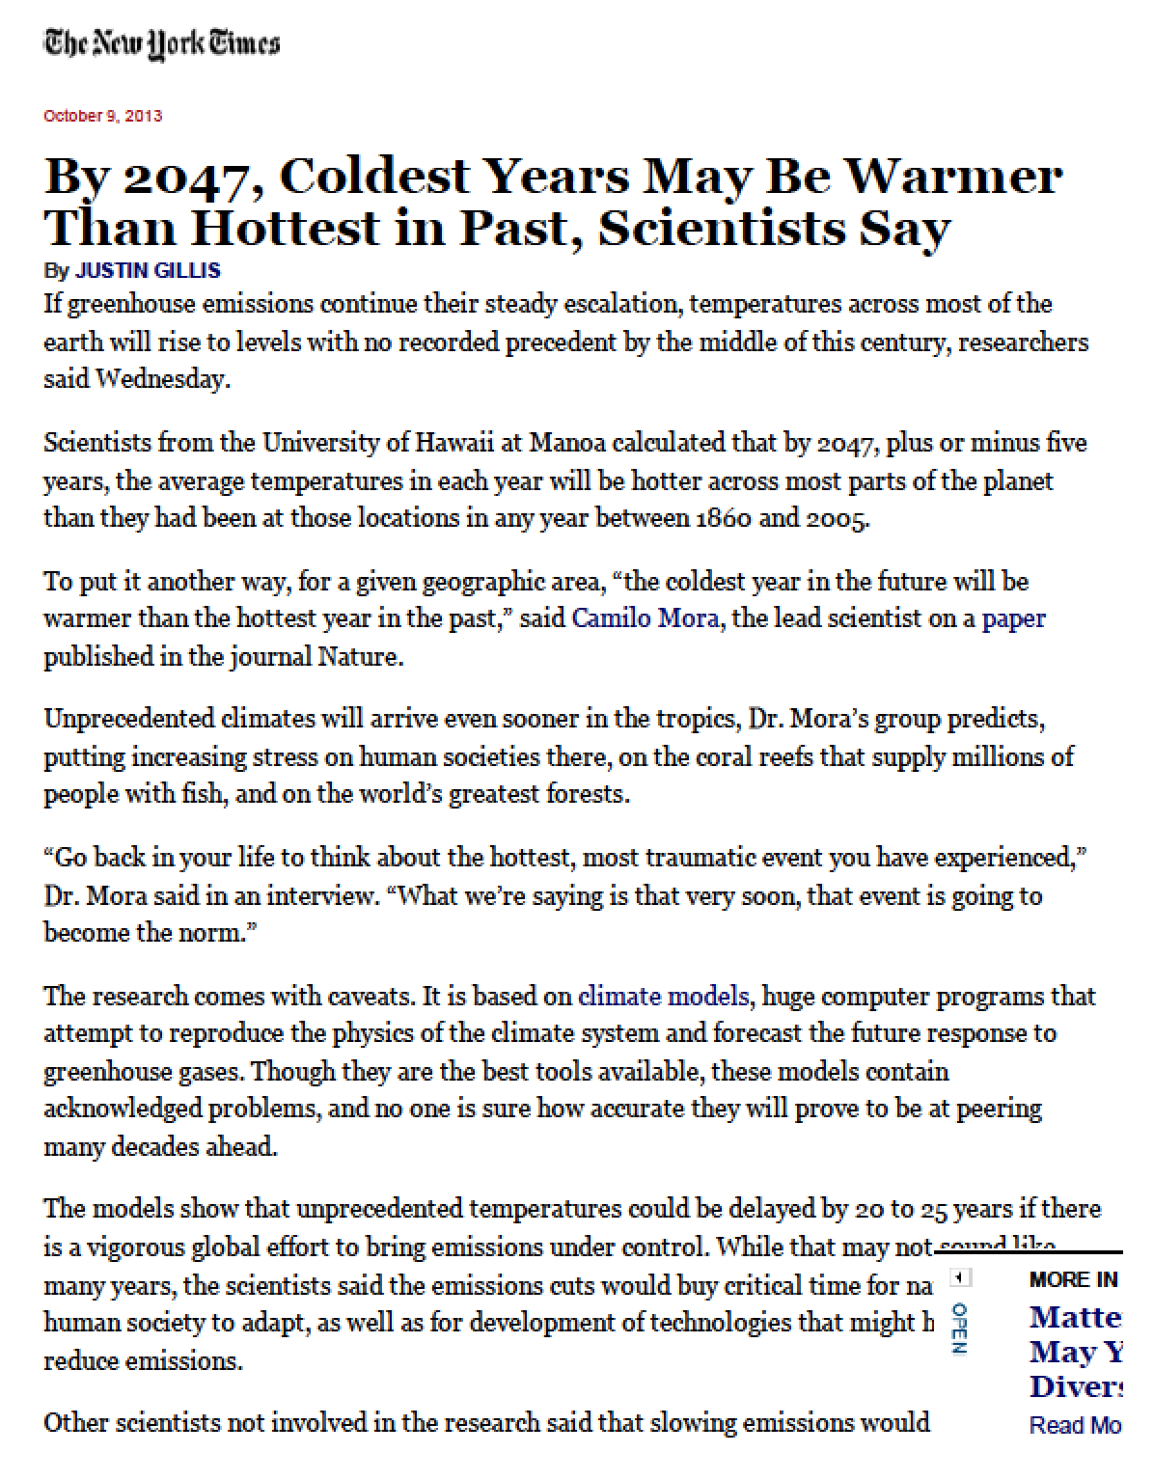
Identifying the Practices:
Climate Science Article
Read the article a to identify some of the 8 Science & Engineering Practices in the article.
Label the text with the # of the practice

Slide 23
Identifying the Practices:
Climate Science Article
Which practices Jumped Out at you?
2- Developing & Using Models
4- Analyzing & Interpreting Data
5- Using Math & Computational Thinking
7- Argumentation

Slide 24
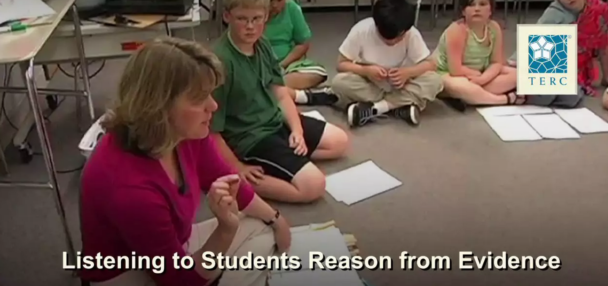
The Science & Engineering Practices in Action in a Classroom
Grade: 3
Question: Do Very Tiny Things Have Weight?
Background: Students conducted observations… now they are making sense of their observations
Take Notes
On p. 7 in your packet

Slide 25
The Science & Engineering Practices in Action in a Classroom
Which practices did we notice?
Questioning
Argumentation
Constructing Explanations
Analyzing & Interpreting Data
Communicating information

Slide 26
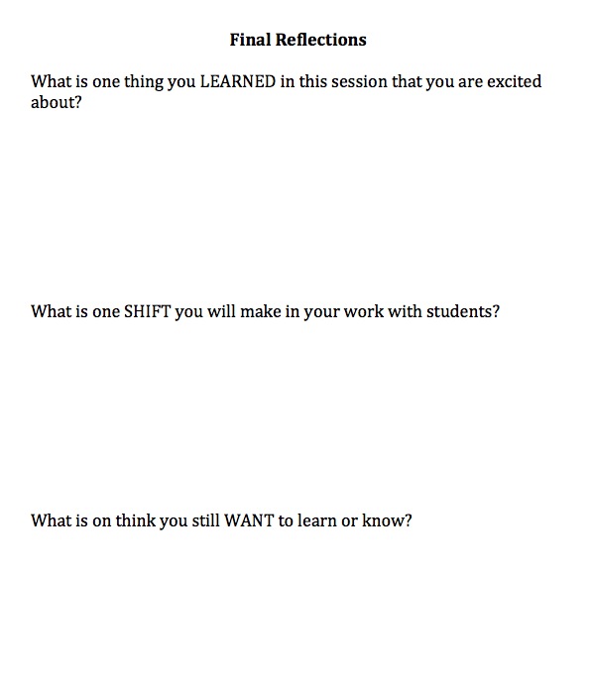
Final Reflection
Page 8 in your packet
Please answer in the Google Form if requested by your district

Slide 27
Next Session: Coming Soon
Next Generation Science Standards 101
Part 3:
Uncovering the Crosscutting Concepts

